Slide 1

Support Vector Machine
Data Mining– Final Week 2
Humaira Anzum Neha
Lecturer
Dept of CSE, UIU
humaira@cse.uiu.ac.bd

Slide 2

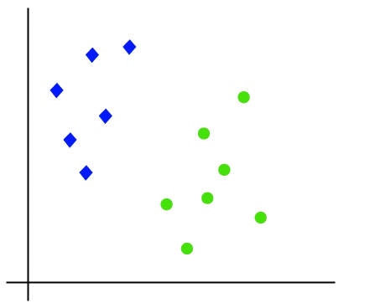
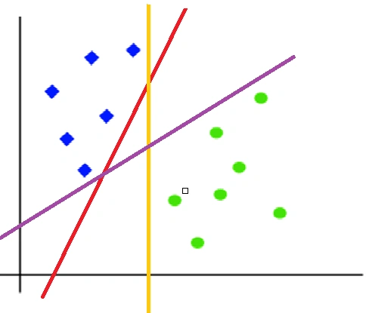
What is SVM?
  Supervised machine learning used for classification
  SVM tries to find a hyperplane(the line) that best separates the two classes.

Slide 3
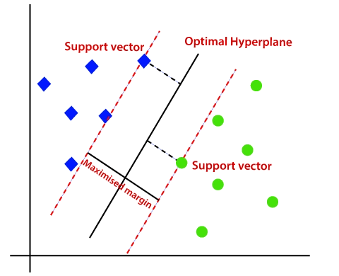
What is SVM?
  Which hyperplane would be the best?
SVM and the Best Hyperplane:
Goal of SVM: To find the line (hyperplane) that best separates two classes.
How it works: SVM looks for different hyperplanes that can separate the classes, then chooses the one that is farthest away from the data points of both classes.
Why? The farther the hyperplane is from the data points, the bigger the margin, which makes the classification more confident and accurate.

Slide 4
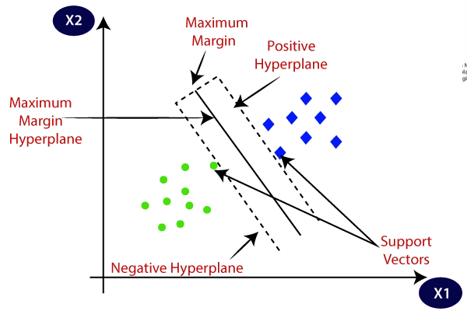
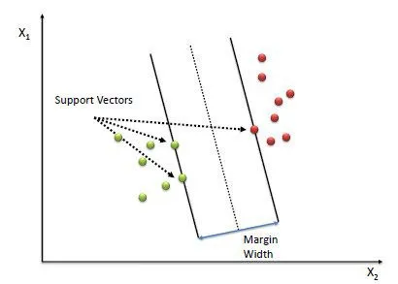
What is SVM?
    Support Vectors: These are the data points that are closest to the hyperplane (the line separating the classes). Why are they important? The hyperplane (or decision boundary) is defined using these points.
    Margin- The margin is the distance from the hyperplane to the closest data point of either class. Goal: The margin should be as large as possible for better classification.

Slide 5
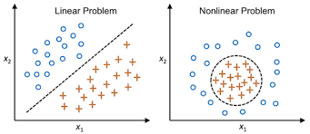
Types of SVM
    Linear SVM: When the data is perfectly linearly separable only then we can use Linear SVM. Perfectly linearly separable means that the data points can be classified into 2 classes by using a single straight line(if 2D).
    Non-Linear SVM: When the data is not linearly separable then we can use Non-Linear SVM, which means when the data points cannot be separated into 2 classes by using a straight line (if 2D) then we use some advanced techniques like kernel tricks to classify them. In most real-world applications we do not find linearly separable datapoints hence we use kernel trick to solve them.

Slide 6
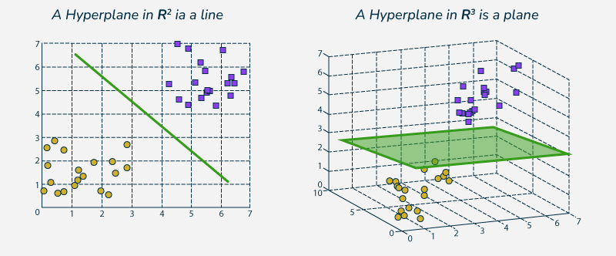
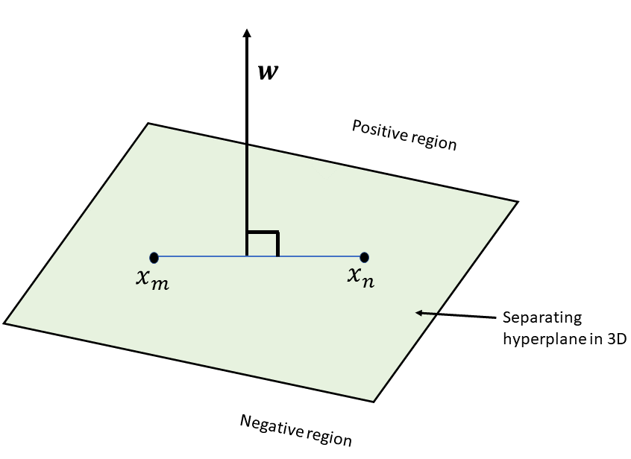
Mathematical Intuition
    General form of Eqn of a hyperplane in 2D : ax + by + c =0
    Another way : w1x1 + w2x2 + w0 =0
    For N-D : w1x1 + w2x2 + …. + wNxN + w0 =0, or w.x +w0 = 0
    If w0 = 0 that means the hyperplane passes through the origin.
    w and x are perpendicular.

Slide 7
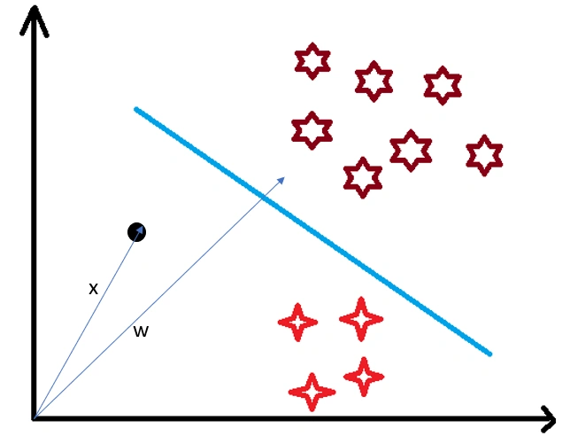
Mathematical Intuition
    Consider a random point X and we want to know whether it lies on the right side of the plane or the left side of the plane (positive or negative).

Slide 8
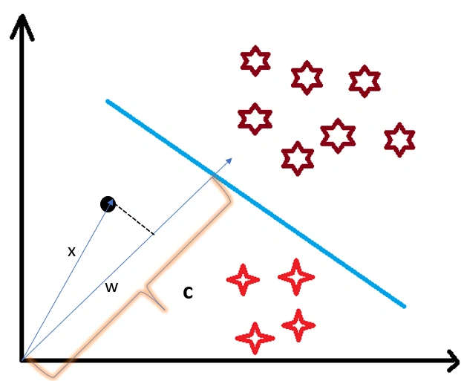
Mathematical Intuition
    To find this first we assume this point is a vector (X) and then we make a vector (w) which is perpendicular to the hyperplane. Let’s say the distance of vector w from origin to decision boundary is ‘c’. Now we take the projection of X vector on w.

Slide 9
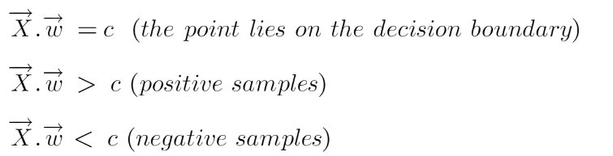
Mathematical Intuition
    We know that projection of any vector or another vector is called dot-product. Hence, we take the dot product of x and w vectors. If the dot product is greater than ‘c’ then we can say that the point lies on the right side. If the dot product is less than ‘c’ then the point is on the left side and if the dot product is equal to ‘c’ then the point lies on the decision boundary.

Slide 10
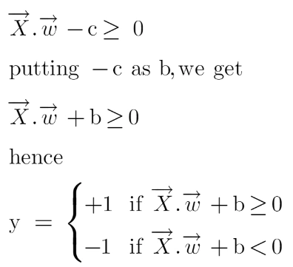
Mathematical Intuition
    To classify a point as negative or positive we need to define a decision rule. We can define decision rule as:

Slide 11
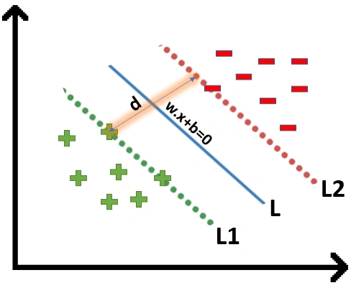
Mathematical Intuition
    If the value of w.x+b>0 then we can say it is a positive point otherwise it is a negative point. Now we need (w,b) such that the margin has a maximum distance. Let’s say this distance is ‘d’.
    To calculate ‘d’ we need the equation of L1 and L2.
    For this, we will take few assumptions that the equation of L1 is w.x+b=1 and for L2 it is w.x+b=-1.

Slide 12
Mathematical Intuition
    To calculate ‘d’ we need the equation of L1 and L2. For this, we will take few assumptions that the equation of L1 is w.x+b=1 and for L2 it is w.x+b=-1.
    Why the magnitude is equal, why didn’t we take 1 and -2?
    Why did we only take 1 and -1, why not any other value like 24 and -100?
    Why did we assume this line?

Slide 13
Mathematical Intuition
    To calculate ‘d’ we need the equation of L1 and L2. For this, we will take few assumptions that the equation of L1 is w.x+b=1 and for L2 it is w.x+b=-1.
    Why the magnitude is equal, why didn’t we take 1 and -2?
      We want our plane to have equal distance from both the classes that means L should pass through the center of L1 and L2 that’s why we take magnitude equal and opposite.
    Why did we only take 1 and -1, why not any other value like 24 and -24?
      Let’s say the equation of our hyperplane is 2x+3y+3=0 L1: 2x+3y+3=1, L2:2x+3y+3=-1, we observe that even if we multiply the whole equation with some other number the line doesn’t change. Hence for mathematical convenience, we take it as 1.

Slide 14
Mathematical Intuition
    To calculate ‘d’ we need the equation of L1 and L2. For this, we will take few assumptions that the equation of L1 is w.x+b=1 and for L2 it is w.x+b=-1.
    Now the main question is exactly why there’s a need to assume only this line?
      If you multiply these equations by 10, we will see that the parallel line (red and green) gets closer to our hyperplane. For more clarity look at this graph. (https://www.desmos.com/calculator/dvjo3vacyp)
      If we divide this equation by 10 then these parallel lines get bigger. (https://www.desmos.com/calculator/15dbwehq9g)
    The parallel lines depend on (w,b) of our hyperplane, if we multiply the equation of hyperplane with a factor greater than 1 then the parallel lines will shrink and if we multiply with a factor less than 1, they expand.
    We can now say that these lines will move as we do changes in (w,b) and this is how this gets optimized.

Slide 15
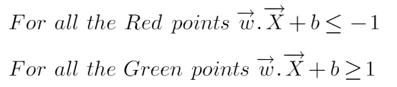

Mathematical Intuition
    We’ll calculate the distance (d) in such a way that no positive or negative point can cross the margin line”.
Rather than taking 2 constraints forward, we’ll now try to simplify these two constraints into 1. We assume that negative classes have y=-1 and positive classes have y=1.
We can say that for every point to be correctly classified this condition should always be true:

Slide 16
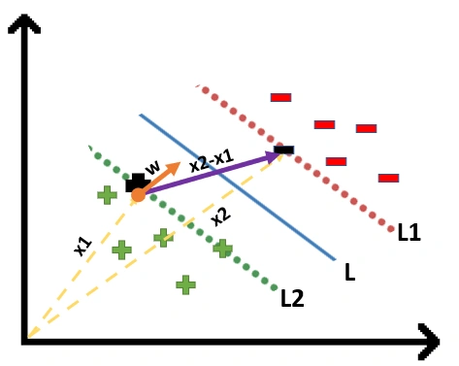
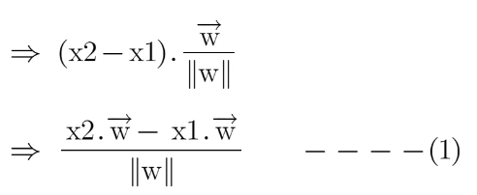
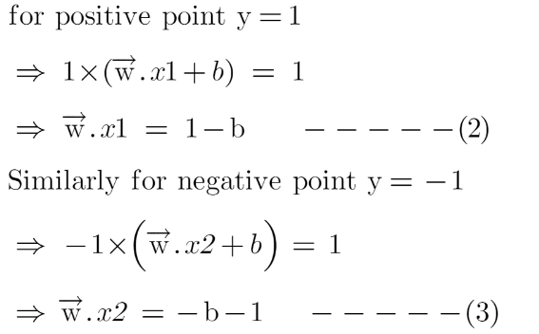
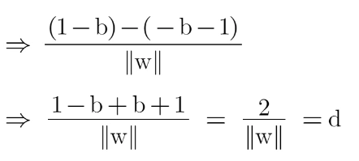
Mathematical Intuition
The distance between these two vectors x1 and x2 will be (x2-x1) vector. What we need is, the shortest distance between these two points which can be found using a trick we used in the dot product. We take a vector ‘w’ perpendicular to the hyperplane and then find the projection of (x2-x1) vector on ‘w’.
Putting equations (2) and (3) in equation (1) we get:

Slide 17
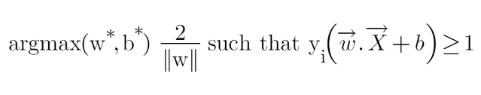

Mathematical Intuition
Hence the equation which we have to maximize is:
it is common practice to minimize a cost function for optimization problems; therefore, we can invert the function.
we don’t find this type of perfectly linearly separable data in the industry, there is hardly any case we get this type of data and hence we fail to use this condition we proved here. The type of problem which we just studied is called Hard Margin SVM now we shall study soft margin which is similar to this but there are few more interesting tricks we use in Soft Margin SVM.

Slide 18
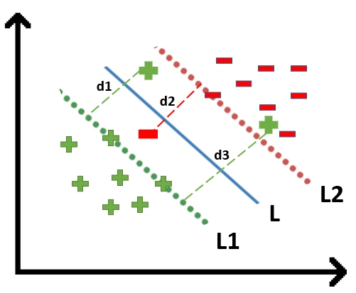
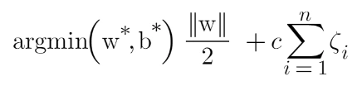
Soft Margin SVM
In real-life applications, we rarely encounter datasets that are perfectly linearly separable. Instead, we often come across datasets that are either nearly linearly separable or entirely non-linearly separable.
To tackle this problem what we do is modify that equation in such a way that it allows few misclassifications that means it allows few points to be wrongly classified.
To make a soft margin equation we add 2 more terms to this equation which is zeta and multiply that by a hyperparameter ‘c’
For all the correctly classified points our zeta will be equal to 0 and for all the incorrectly classified points the zeta is simply the distance of that particular point from its correct hyperplane that means if we see the wrongly classified green points the value of zeta will be the distance of these points from L1 hyperplane and for wrongly classified redpoint zeta will be the distance of that point from L2 hyperplane.

Slide 19
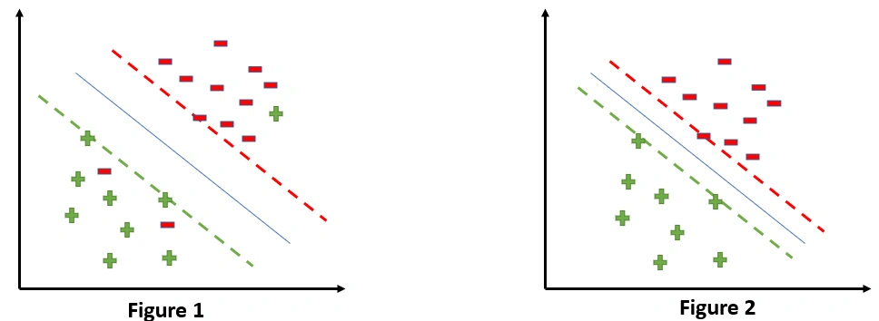
Soft Margin SVM
SVM Error = Margin Error + Classification Error. The higher the margin, the lower would-be margin error, and vice versa.
Let’s say you take a high value of ‘c’ =1000, this would mean that you don’t want to focus on margin error and just want a model which doesn’t misclassify any data point.

Slide 20
Soft Margin SVM
.
If someone asks you which is a better model, the one where the margin is maximum and has 2 misclassified points or the one where the margin is very less, and all the points are correctly classified?
Well, there’s no correct answer to this question, but rather we can use
SVM Error = Margin Error + Classification Error to justify this. If you don’t want any misclassification in the model then you can choose figure 2. That means we’ll increase ‘c’ to decrease Classification Error but if you want that your margin should be maximized then the value of ‘c’ should be minimized. That’s why ‘c’ is a hyperparameter and we find the optimal value of ‘c’ using GridsearchCV and cross-validation.

Slide 21
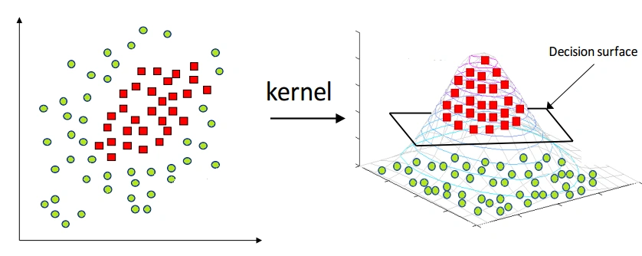
Kernels in Support Vector Machine
The most interesting feature of SVM is that it can even work with a non-linear dataset and for this, we use “Kernel Trick” which makes it easier to classifies the points. Suppose we have a dataset like this:
So what we do is try converting this lower dimension space to a higher dimension space using some quadratic functions which will allow us to find a decision boundary that clearly divides the data points. These functions which help us do this are called Kernels and which kernel to use is purely determined by hyperparameter tuning.

Slide 22
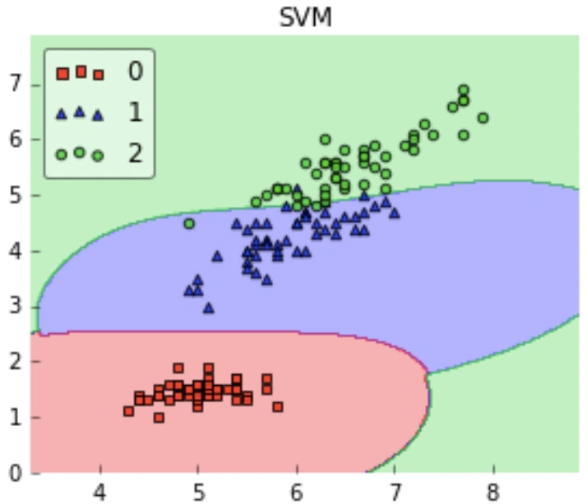
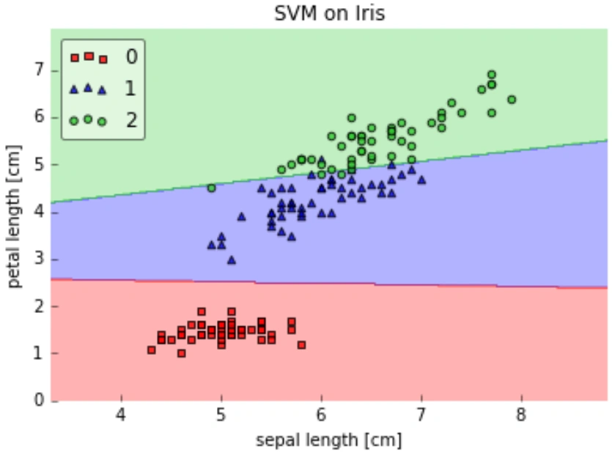
How to Choose the Right Kernel?
Choosing a kernel totally depends on what kind of dataset are you working on. If it is linearly separable then you must opt. for linear kernel function since it is very easy to use and the complexity is much lower compared to other kernel functions

Slide 23
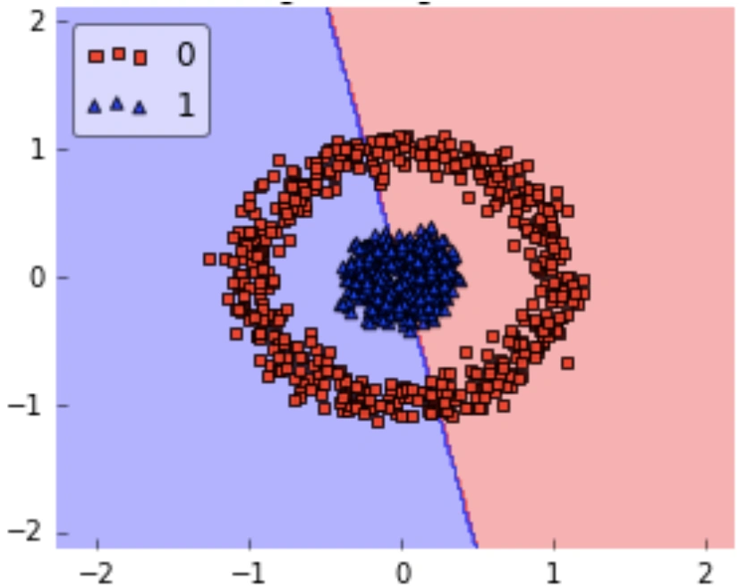
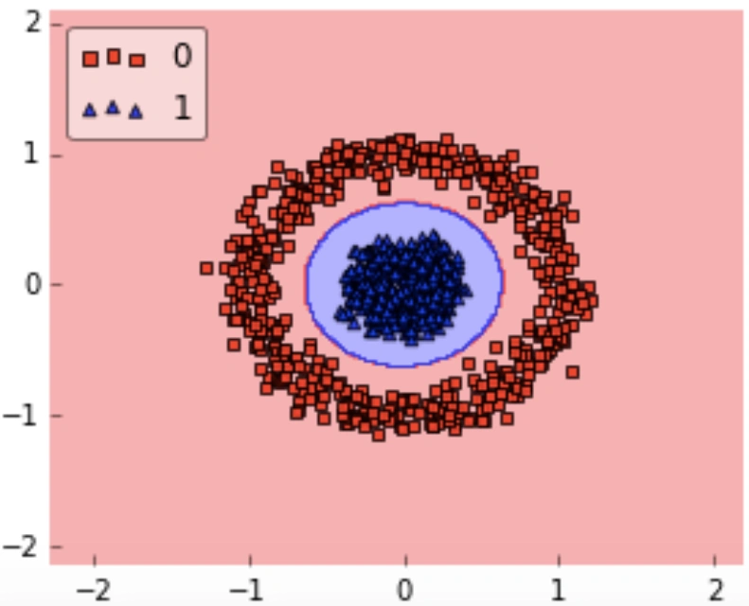
How to Choose the Right Kernel?
If the dataset is not linear then using linear kernel doesn’t make sense we’ll get a very low accuracy if we do so.

Slide 24
More about SVM
https://www.analyticsvidhya.com/support-vector-machine/
https://www.analyticsvidhya.com/blog/2021/06/support-vector-machine-better-understanding/

